Slide 1
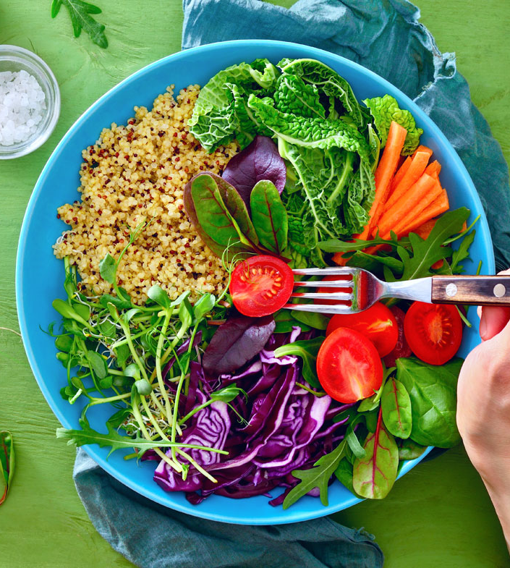
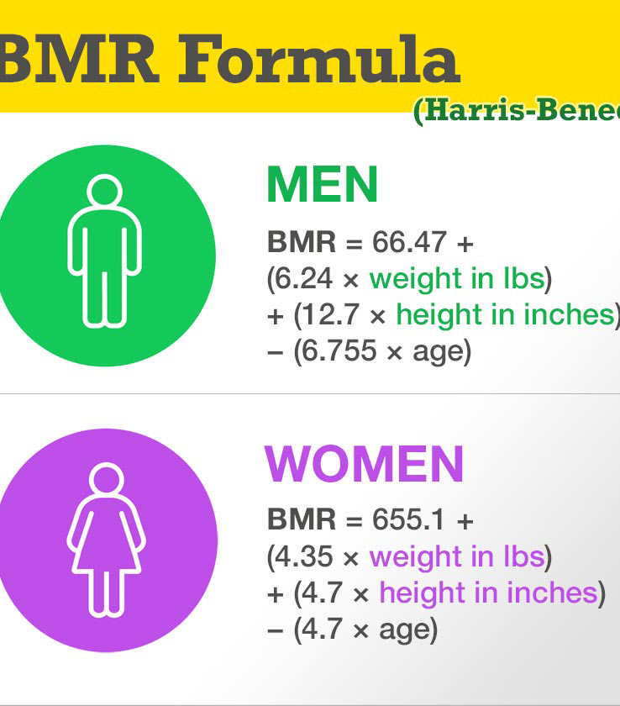
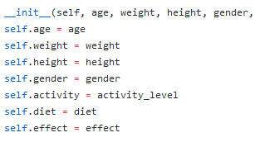
CITRUS FRUIT
An all-in-one nutrition calculator and tracker to help you lose weight and eat healthy.
Developer: Jackie Wong

